Slide 1



Virtualization for Real-time Power Grid Substation Automation
Annual review
November 21, 2021

Slide 2
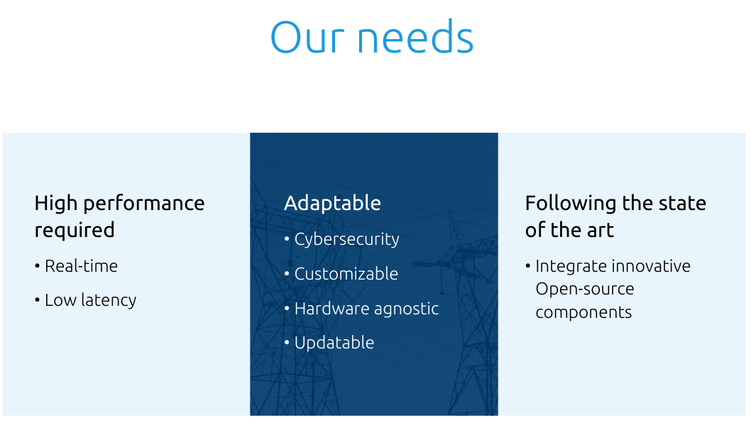
Scope of the project
Develop a “reference design” and “industrial grade” open source real-time platform that can run virtualized automation and protection applications (for the power grid industry in the first place and potentially beyond). This platform is intended to host multi-provider applications

Slide 3
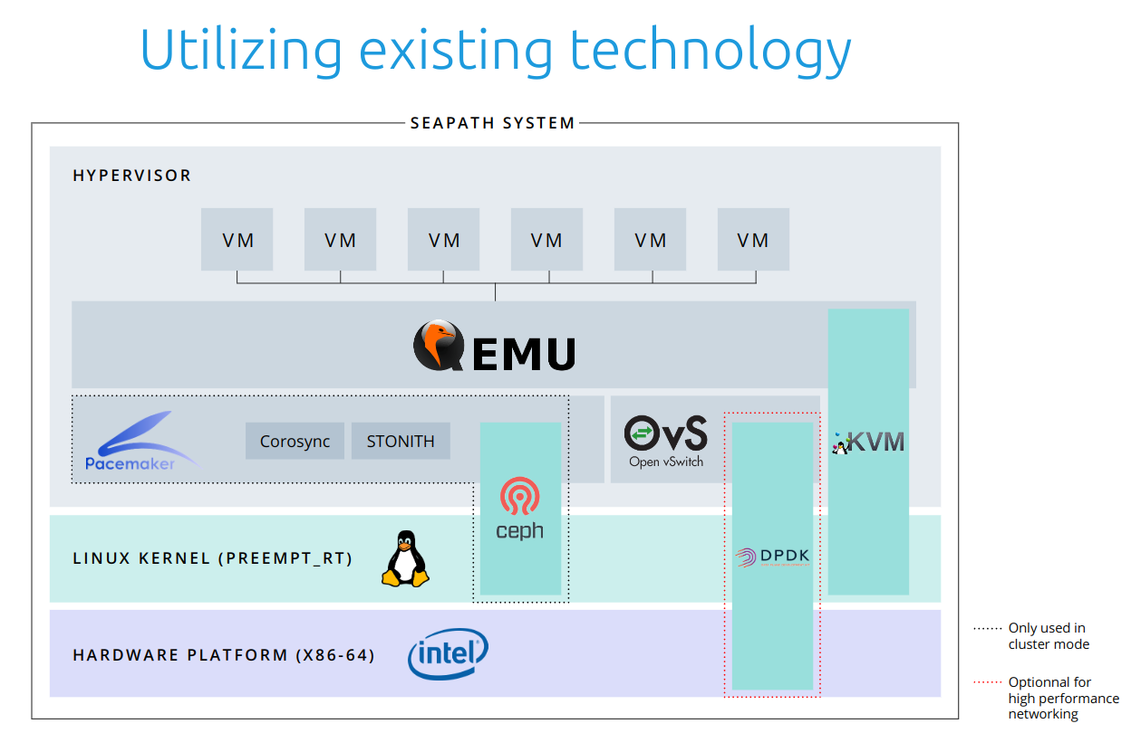
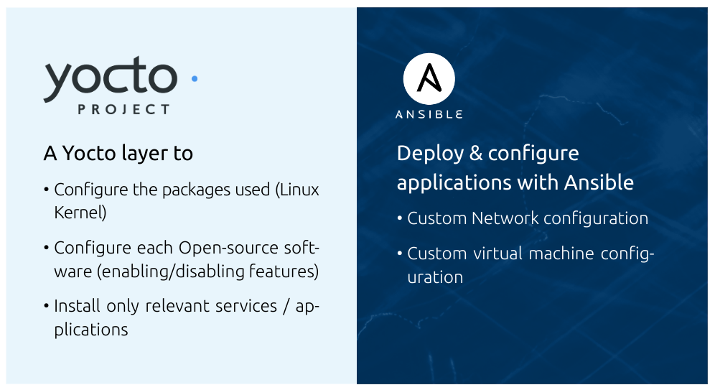
Do not want to reinvent the wheel

Slide 4
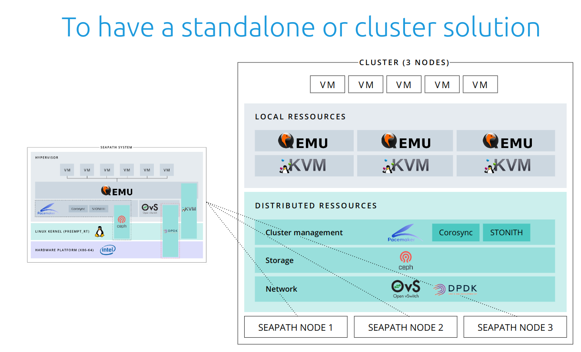
Scalable and High availability solution

Slide 5
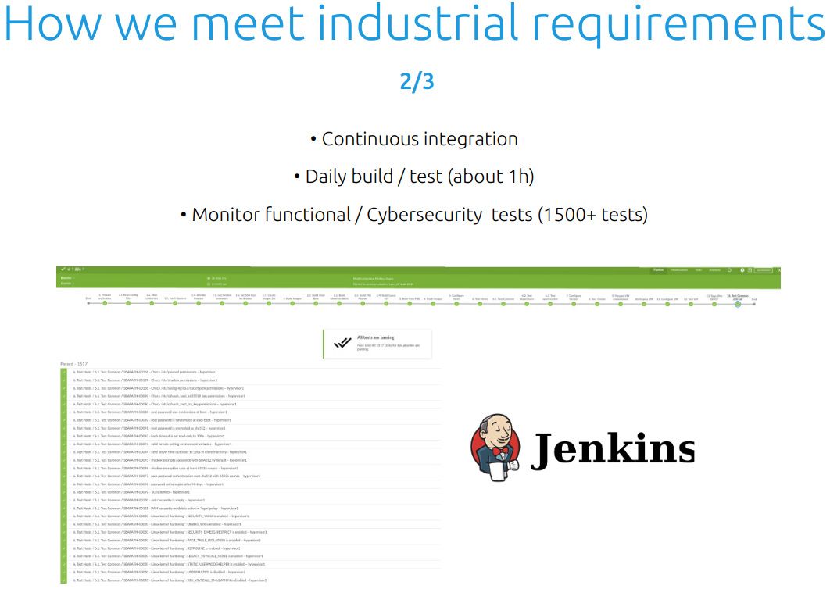
Continous Integration

Slide 6
Incubation stage requirements 1/3
Have an open and documented technical governance, including:
A LICENSE file in every code repository, with the license chosen an OSI-approved license. [✓]
A README file welcoming new community members to the project and explaining why the project is useful and how to get started.[✓]
A CONTRIBUTING file explaining to other developers and your community of users how to contribute to the project. The file should explain what types of contributions are needed and how the process works.[✓]
A CODEOWNERS or COMMITTERS file to define individuals or teams that are responsible for code in a repository; document current project owners and current and emeritus committers. [✓]
A CODE_OF_CONDUCT file that sets the ground rules for participants’ behavior associated and helps to facilitate a friendly, welcoming environment. [✓]
A RELEASE file that provides documentation on the release methodology, cadence, criteria, etc.[ -- ]
A GOVERNANCE file that documents the project’s technical governance.[✓]
A SUPPORT file to let users and developers know about ways to get help with your project.[✓]
Complete and approve the Technical Charter.[✓]
Have achieved and maintained a Core Infrastructure Initiative Best Practices Badge at the ‘Passing’ level [✓]
Have had a successful license scan with any critical issues remedied.[✓]

Slide 7
Incubation stage requirements 2/3
An overview of the project’s architecture and features defined.[✓]
A project roadmap defined, which should address the following questions.[✓]
What use cases are possible now?
Deploy a standalone secure version of SEAPATH
Deploy a cluster (High Availability infrastructure) secure version of SEAPATH
Deploy and manage virtual machine with Ansible on the SEAPATH Platform
Deploy a CI to buid, test the images and deploy them on x86_64 intel Hardware
What does the next year look like in terms of additional features and use cases covered?
Build a SandBox that is easy to use (without any security features)
Enhance the project issue tracking system
Enhance the documentation to make it easier to go onboard
Work on real time performance configuration for critical real time application

Slide 8
Incubation stage requirements 3/3
Community and contributor growth assessment
The current number of contributors and committers, and the number of different organizations contributing to the project
Contributor : GE (code contribution ) , Advantech (advices on hardware) , Schneider (participation to TSC meeting)
Committers : SFL/RTE/Alliander
Demonstrate a sustained flow of commits / merged contributions [✓]
A credible plan for developing a thriving user community, in particular expanding the number of committers and contributors?
First focus is to make the onboarding process easier by flattening the learning curve
Outline of the plan for the project to complete the requirements for Adopted Stage
Having a functional sandbox
Having a process/tutorial that make it possible to deploy a 3 machines SEAPATH cluster/virtualcluster and put VM on top of it in less than 2 hours (including configuration)
Receive the affirmative majority vote of the TAC. [ ✓]

